Slide 1


Data Analytics Project MASAI SCHOOL
Investment Advisor
By Akash Pandharinath Nirmal, Pranav Pramod, Pradipta Dey, Sanket Kukwas

Slide 2
Introduction
The project given to us was one where we had to integrate a Google Sheet and a text editor to make sure changes were made to the Sheet via the text editor while using a python library known as Gspread. This would allow dynamic changes to the sheet without having to manually enter them into the sheet.
The process of finding out stocks from a given set of companies and recommend which would be the most ideal ones was the set objective and this was successfully accomplished.

Slide 3
Project Explanation
The project consisted of 3 Google sheets where in which one sheet had the details of all the companies listed on the BSE and certain expenses/income reports while the other sheets had the empty cells which had to be filled with the calculations and manipulations.
The sheets had to be integrated with Google APIs to allow us to integrate new applications with existing software systems. This ensured us that each functionality doesn't have to be written from scratch while also eliminating any time constraints.

Slide 4
The project objectives were as follows:
Finding the Net income and Net expenses and to populate a Gsheet using python code
Finding the cost incurred from different categories of spending
Calculating the Available Money for investment from the Net expense and income
Predicting 5 companies where the money can be invested into
Applying a certain logic to figure out which of these companies are viable options and analyzing the risk of investment
Comparing the median of Enterprise Value(Cr) across different Sectors
Counting the companies in different Industries with positive and negative 3-Year Return
Creating a KPI which can help define the best stock across different Sectors

Slide 5

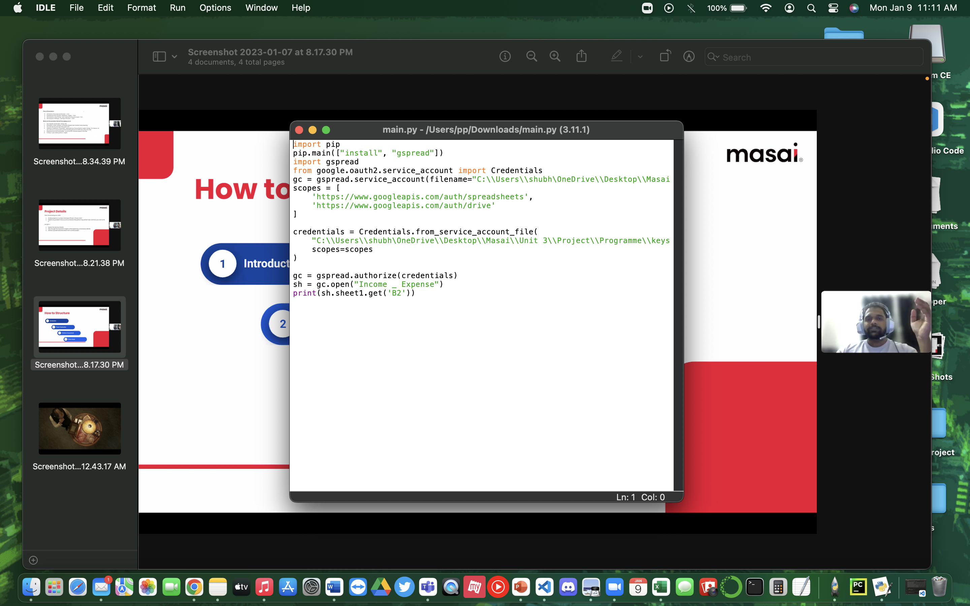

Codes used and Implementaion
The first and most important step was to integrate the Gsheet with the text editor and ensure that changes could be made via the editor. This was done by using the code given here and by enabling certain Google Drive APIs.

Slide 6

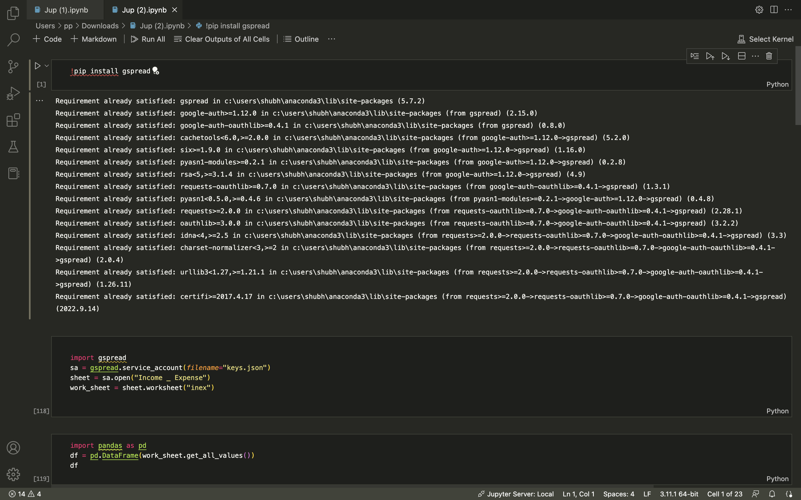
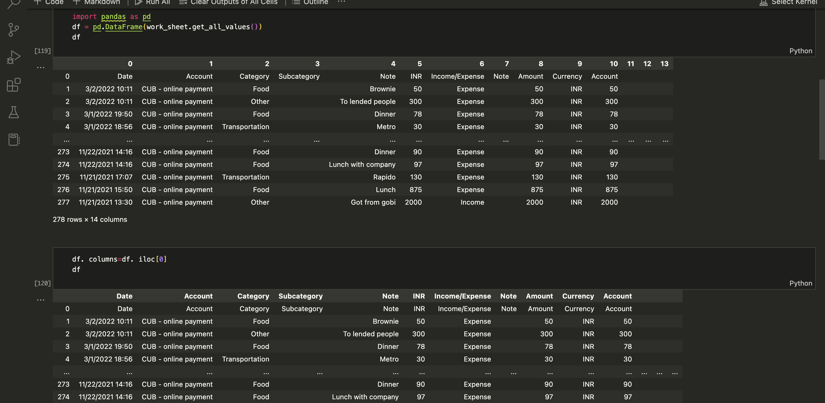
The following code was used in the text editor to access the google sheets and their columns using gspread and python.
A dataframe was created using the pandas library to parse the data.
The dataframe was present in a string format and hence, needed to be converted into float datatypes so that the calculations could be made

Slide 7
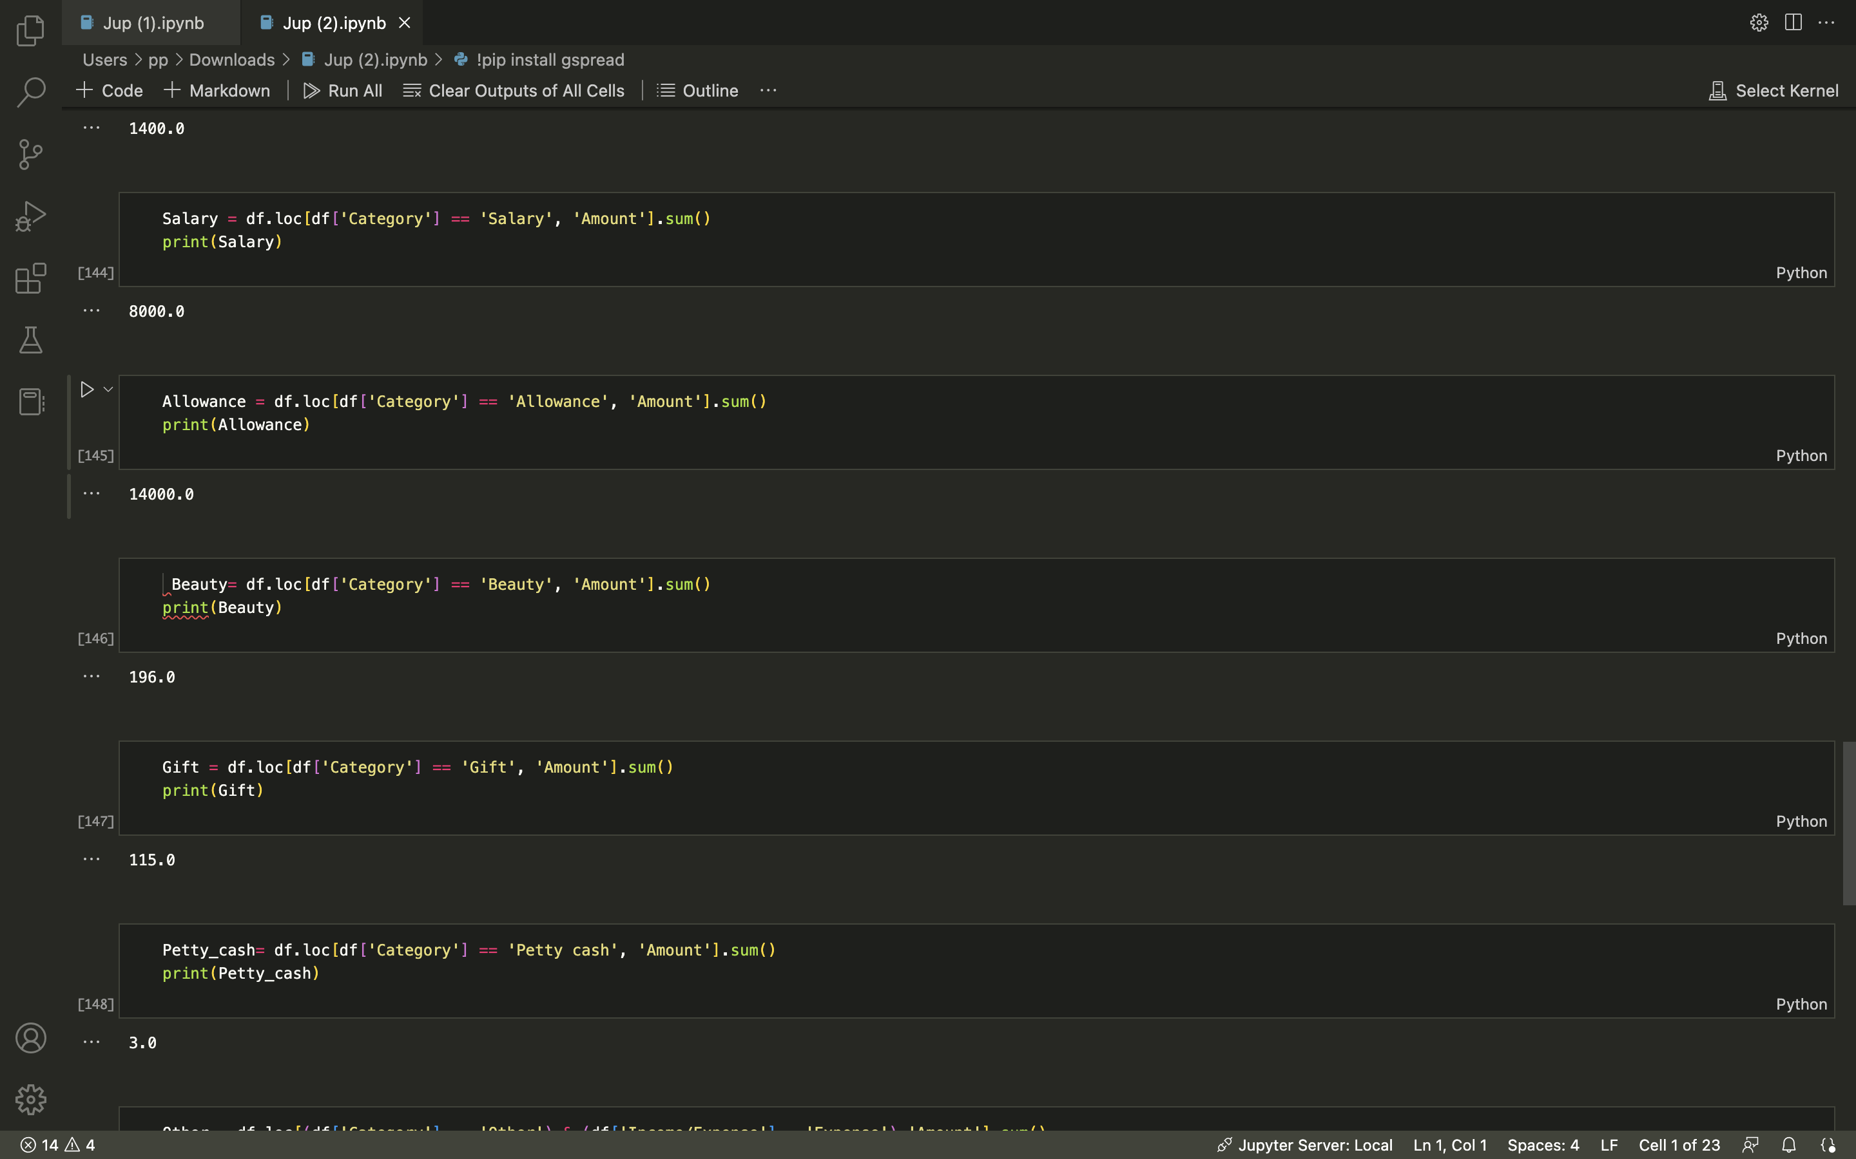
The following code was used to make the calculations
Certain other codes were also used to upload and upgrade the sheet via the text editor.

Slide 8
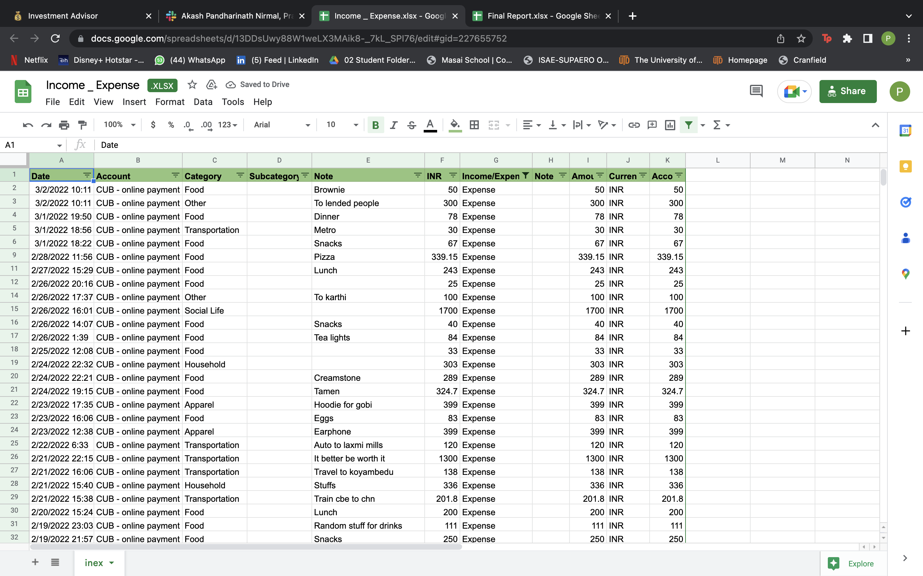
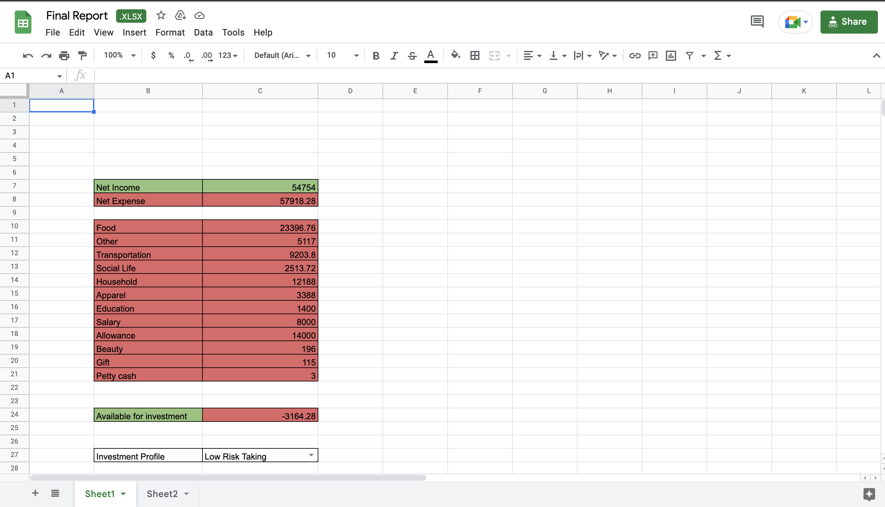
A look at the updated google sheet after calculation
The sheet at the top was the sheet provided to us where we had to find the net income/expenses
The sheet at the bottom is after calculations were made and they were updated dynamically on the sheet via the text editor.

Slide 9
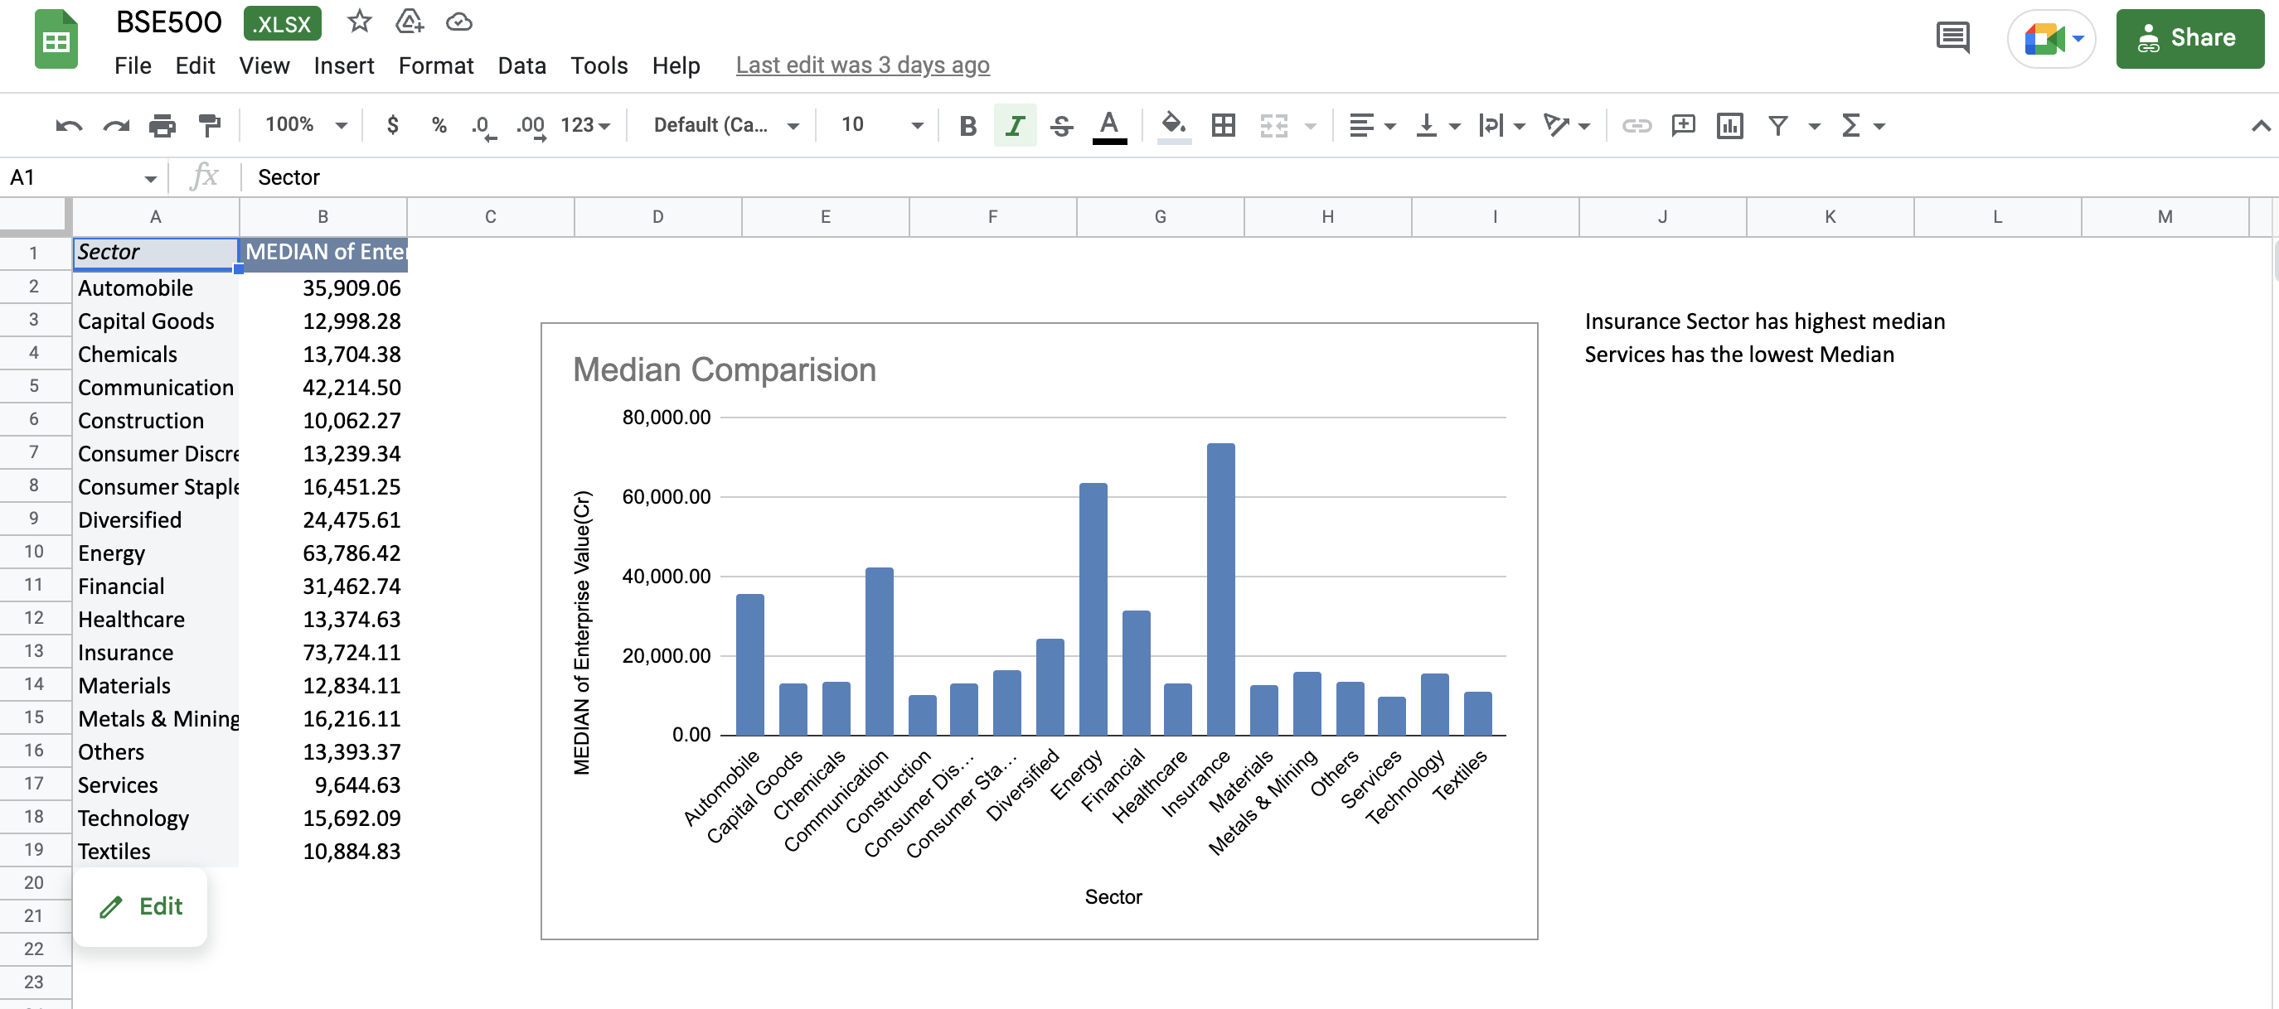
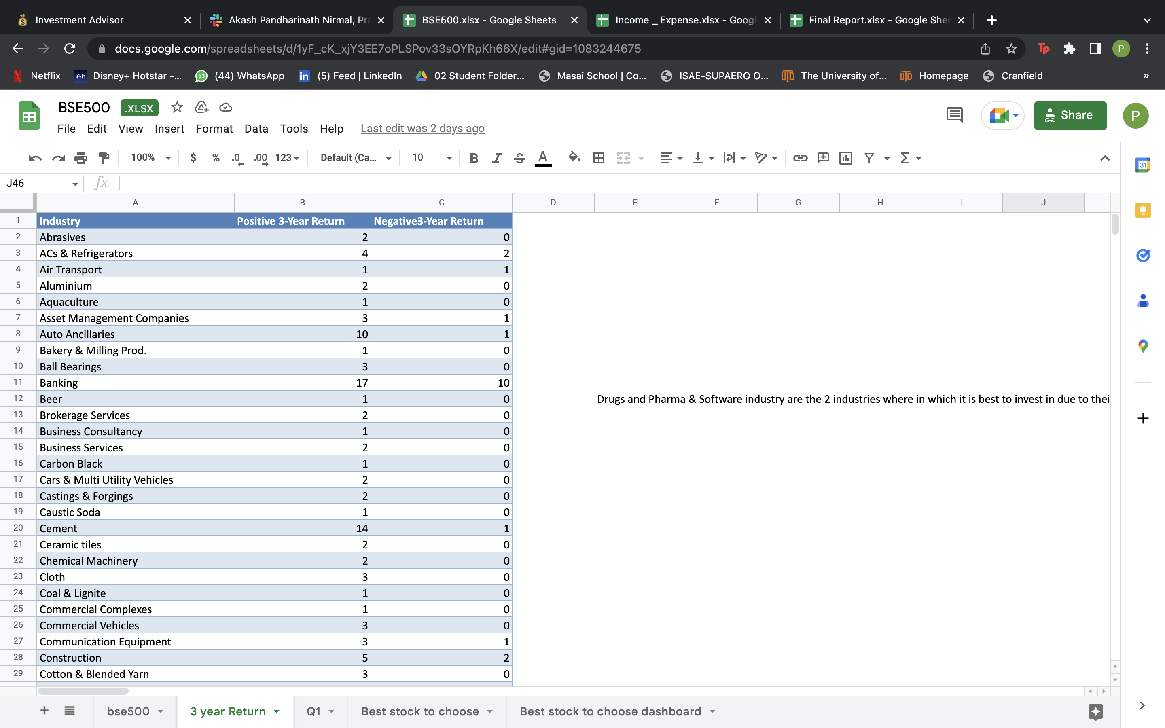
A look at another Task
In the top image, we had to compare the median of the Enterprise Value across different sectors, and this was successfully done. The Insurance sector had the highest median while the Services had the lowest.
In the bottom image, a recommendation had to be made on which is the best industry to invest in based on 3- year returns, it was concluded that the Drugs and pharma & the software industry were the two best.

Slide 10
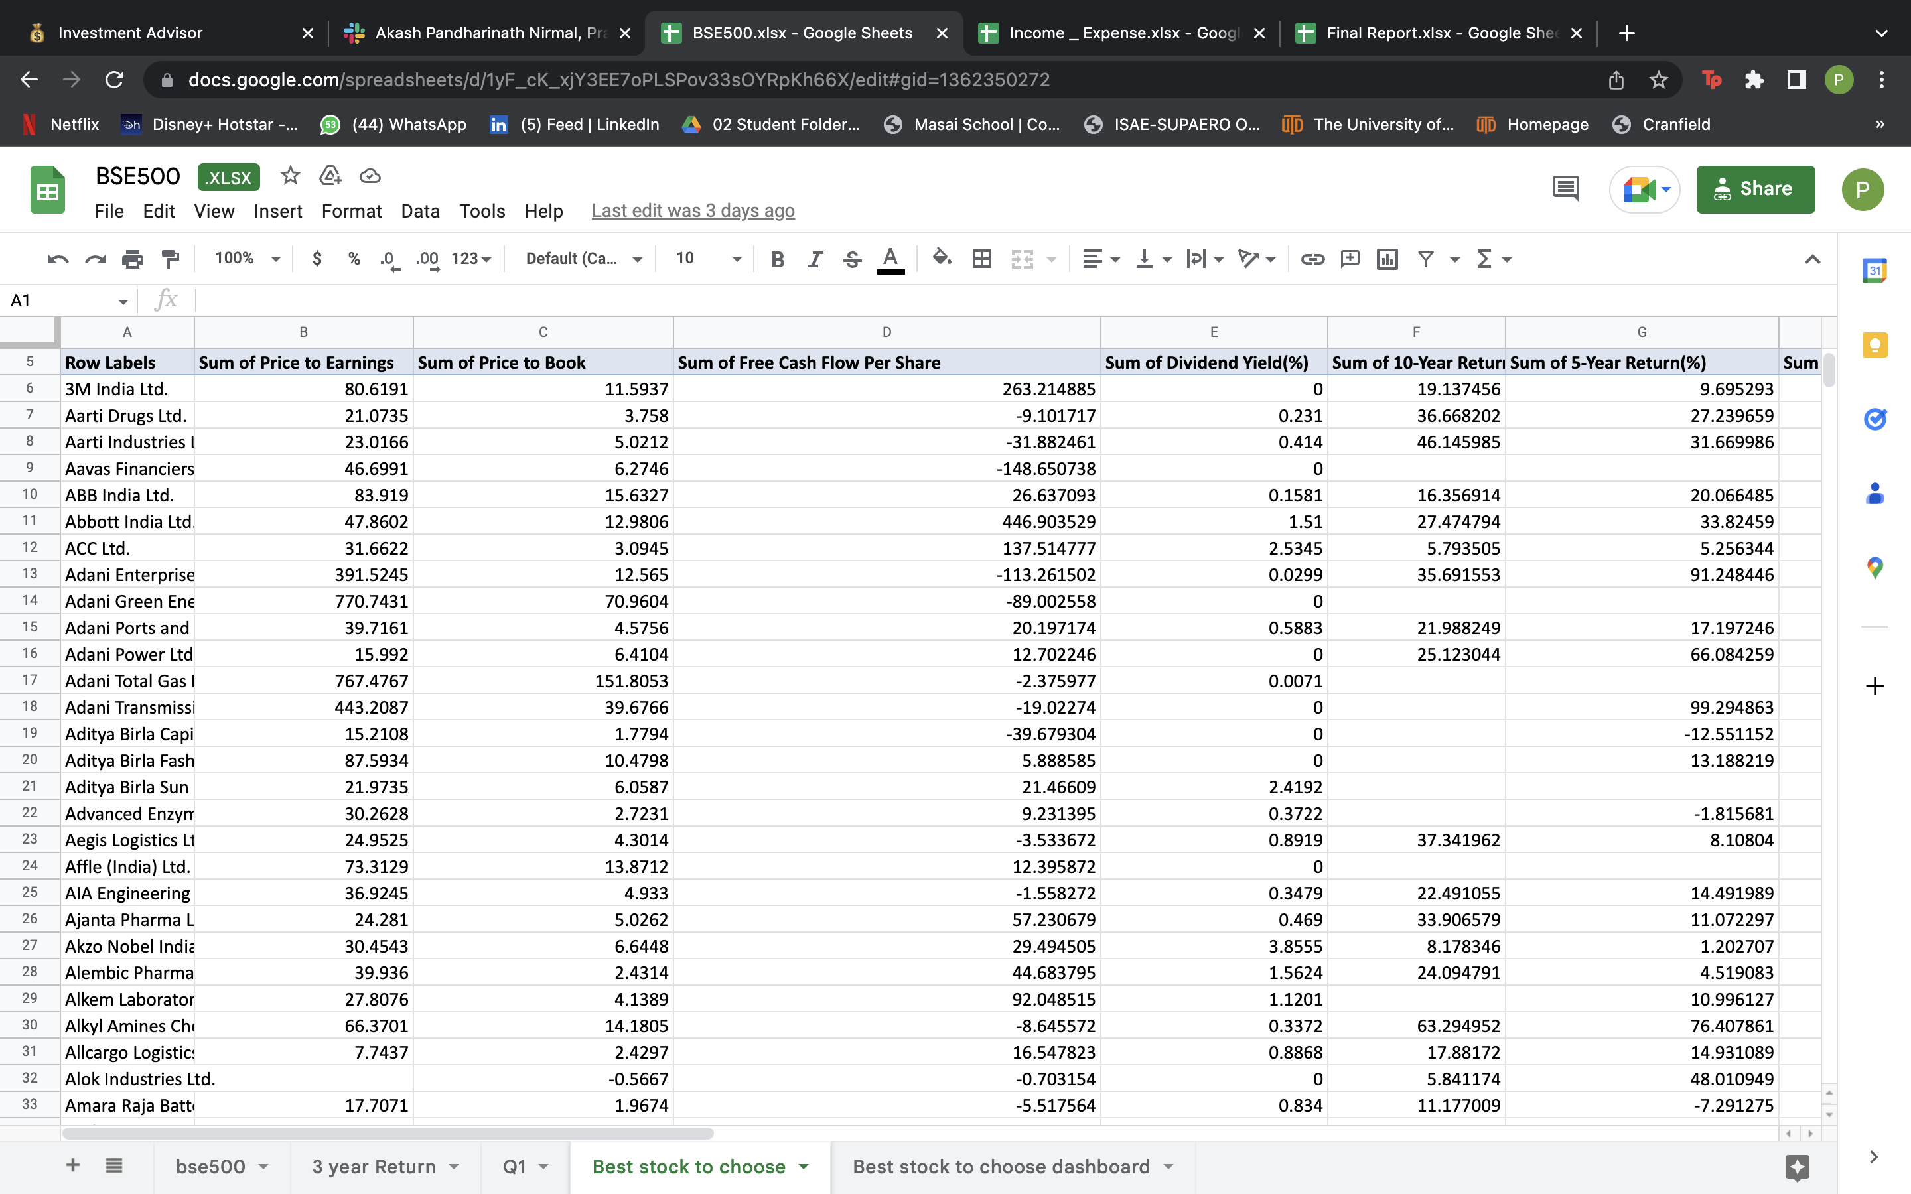
Analysis done to find out a well performing stock for the future

Slide 11

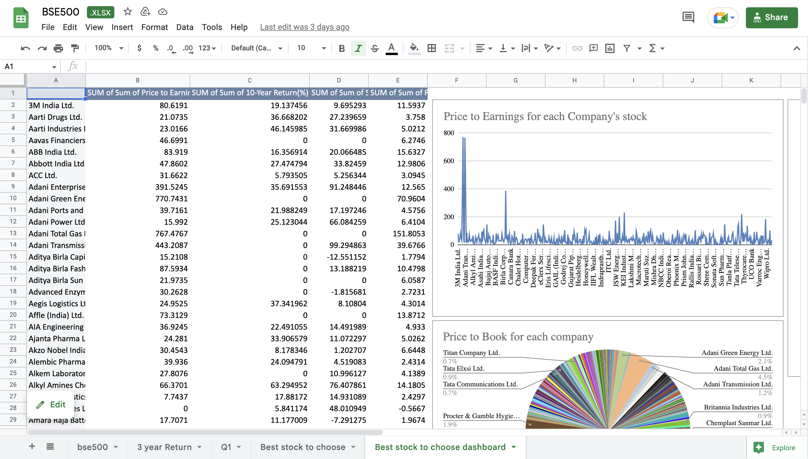
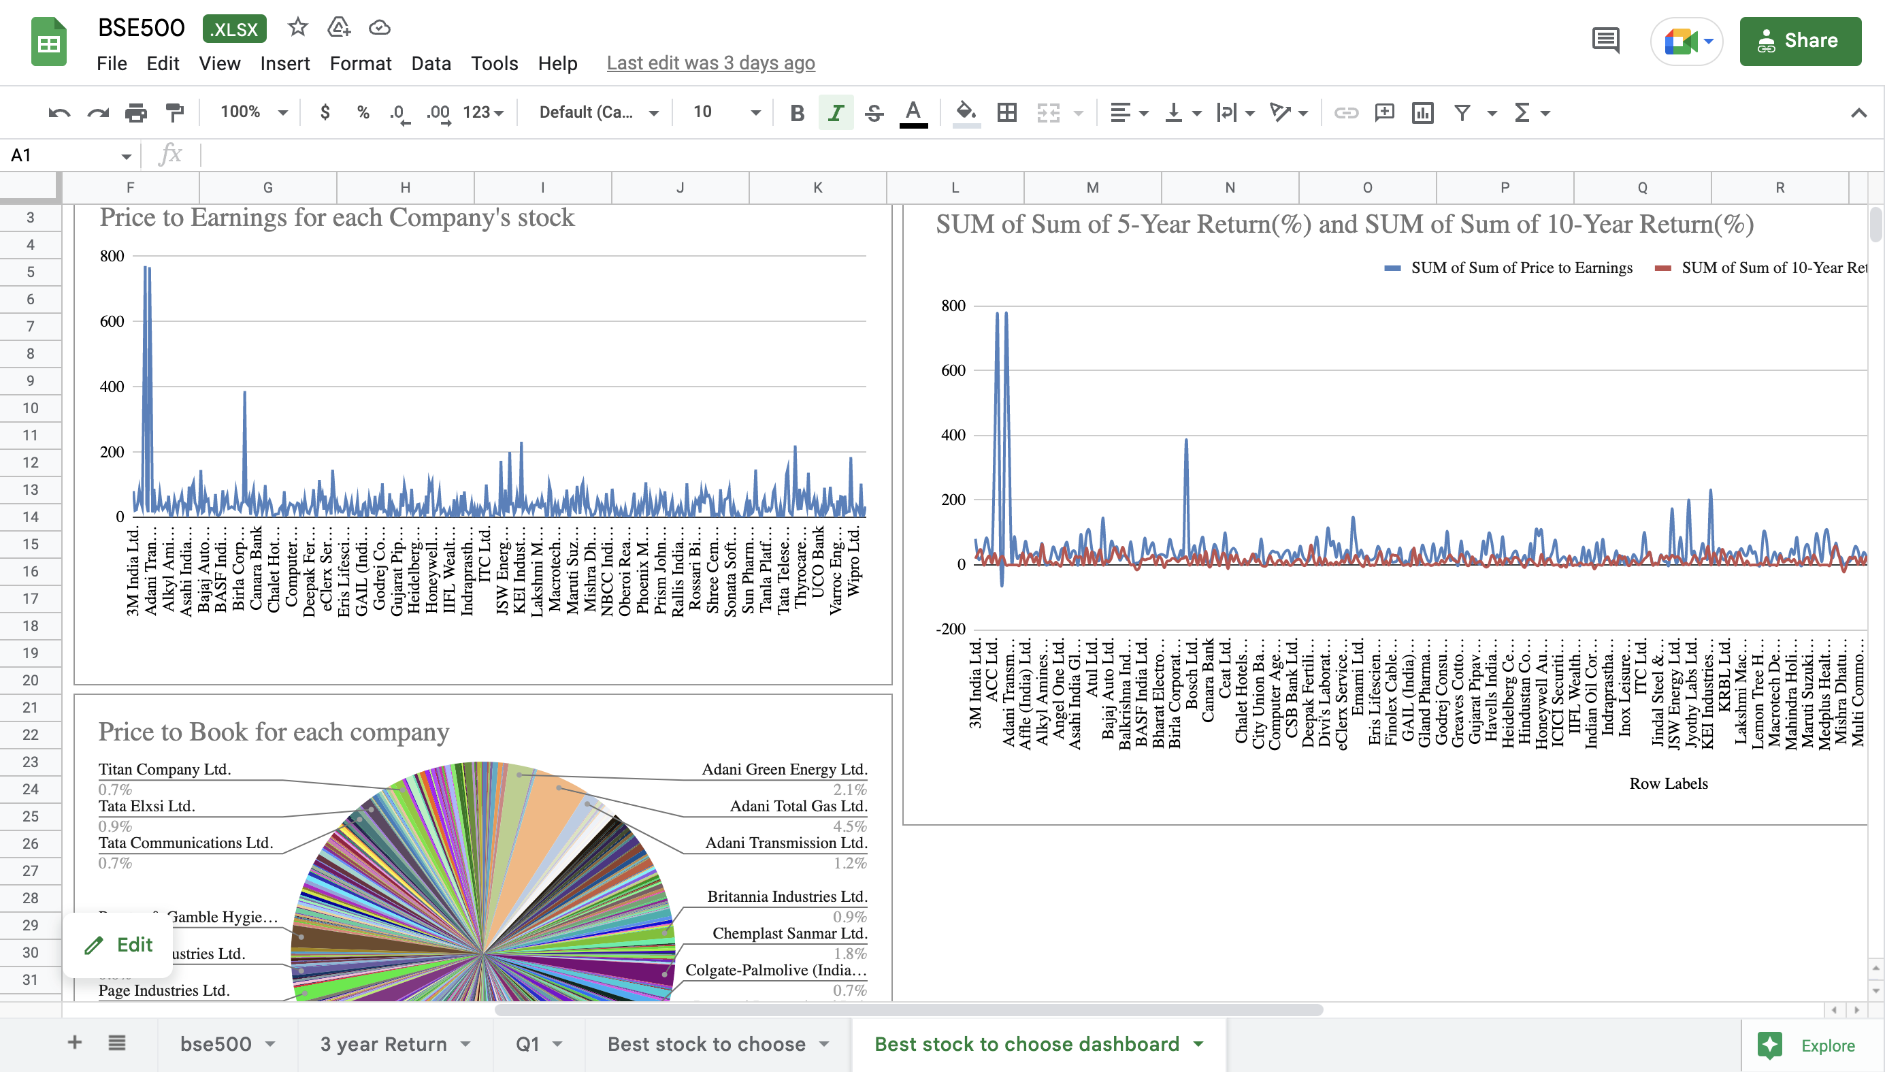
KPI dashboard created to find out a well performing stock

Slide 12
Project obstacles
Most of the problems that were faced had to do with the integration of the gsheet with the editor. We went through some roadblocks in the installing of the packages as well as the APIs as we couldn’t parse the data thoroughly from the sheet.
A minor inconvenience was faced in the calculations of the net income as we were getting errors in them, but we soon overcame them.

Slide 13
Conclusion
The future scope of this project would deal with the successful prediction of stock recommendations for investors with no prior knowledge in the field and help them to invest carefully.
This project when further advanced would also help in figuring out your net expenditure given your income and expenses.

Slide 14
Thank You
We would further like to thank MASAI School for giving us this opportunity to create and participate in this very interesting yet complex project. It has taught us to be diligent in our work and work better in a group
Akash Pandharinath Nirmal, Pranav Pramod, Pradipta Dey, Sanket Kukwas

